Slide 1
Building a salary prediction engine using python and machine learning
CAPSTONE PROJECT
Presented By:
Prateek Mehra – Kumaun University Nainital - Economics

Slide 2
OUTLINE
Problem Statement
System Development Approach
Algorithm & Deployment
Results
Conclusion
Future Scope
References

Slide 3
Problem Statement
Predicting employee salaries accurately helps HR in effective workforce planning and budgeting. This project aims to build a machine learning-based prediction engine to classify employee salaries. The model will predict if an employee earns > $50K or <= $50K based on features like age, education, and hours-per-week. Using historical employee data, it will enable data-driven and fair salary benchmarking.
It will improve HR functionality by reducing manual efforts in salary analysis. The system will enhance scalability in compensation planning and hiring decisions. Ultimately, it will empower HR teams to make faster, informed salary decisions using ML.

Slide 4
System Approach
🖥️ System Requirements
Device Configuration • CPU: Intel i5 12th Gen H Series • GPU: NVIDIA RTX 3050
IDE Used • Google Colab with T4 GPU for faster runtime and efficient model training
🐍 Python & Machine Learning Libraries Used
NumPy & Pandas For efficient data manipulation and analysis
Matplotlib & Seaborn For clear and insightful data visualization
Scikit-Learn For data preprocessing, model selection, building, and evaluation
Pickle For saving and loading trained models
Streamlit To build an interactive app interface for end-users
Ngrok For API gateway and free deployment of the app/website

Slide 5
Algorithm & Deployment
🚀 Workflow of the Process
1️⃣ Import Libraries → NumPy, Pandas, Matplotlib, Seaborn, Scikit-Learn for data handling and ML.
2️⃣ Load Dataset → Load CSV data using Pandas.
3️⃣ EDA & Cleaning → Checked null and duplicate values (removed 52 duplicates).
→ Handled '?' missing values in occupation, workclass, education.
4️⃣ Feature Selection → Selected real-life salary impact features: age, workclass, education, occupation, hours-per- week, native-country, income.

Slide 6
Algorithm & Deployment
5️⃣ Outlier & Categorical Analysis
→ Boxplot for age (range 18–78 years).
→ CountPlot to clean low-impact education categories.
6️⃣ Data Preparation → Split data into features & target (income).
→ Label Encoding for categorical variables.
→ Train-test split using Scikit-Learn.
7️⃣ Model Building → Trial model: Logistic Regression (accuracy: 74.56%).
→ Tested multiple models (RF, SVM, KNN, Gradient Boosting).
→ Gradient-Boosting-Classifier achieved 80% accuracy.

Slide 7
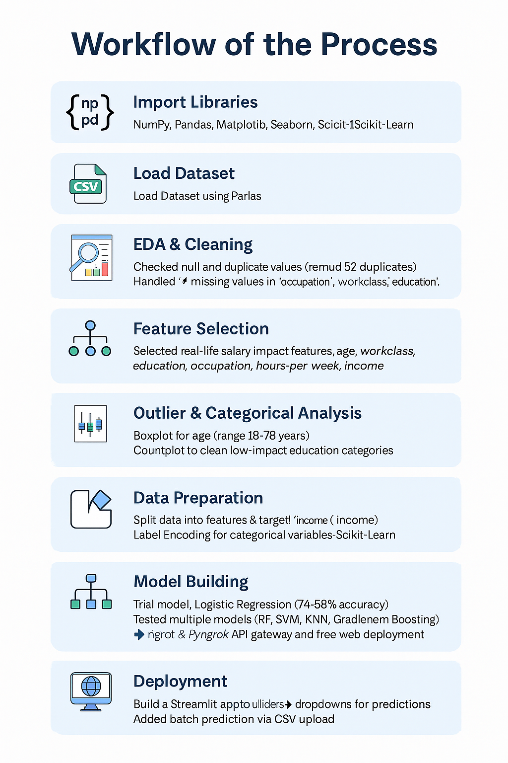
Algorithm & Deployment
8️⃣ Deployment
→ Built Streamlit app with sliders & dropdowns for predictions.
→ Added batch prediction via CSV upload.
→ Used Ngrok & Pyngrok for API gateway and free web deployment.

Slide 8
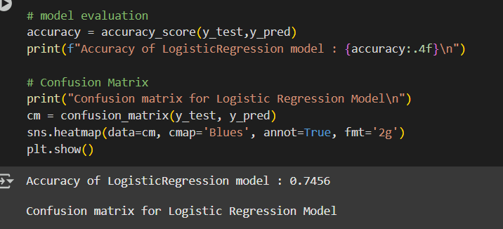
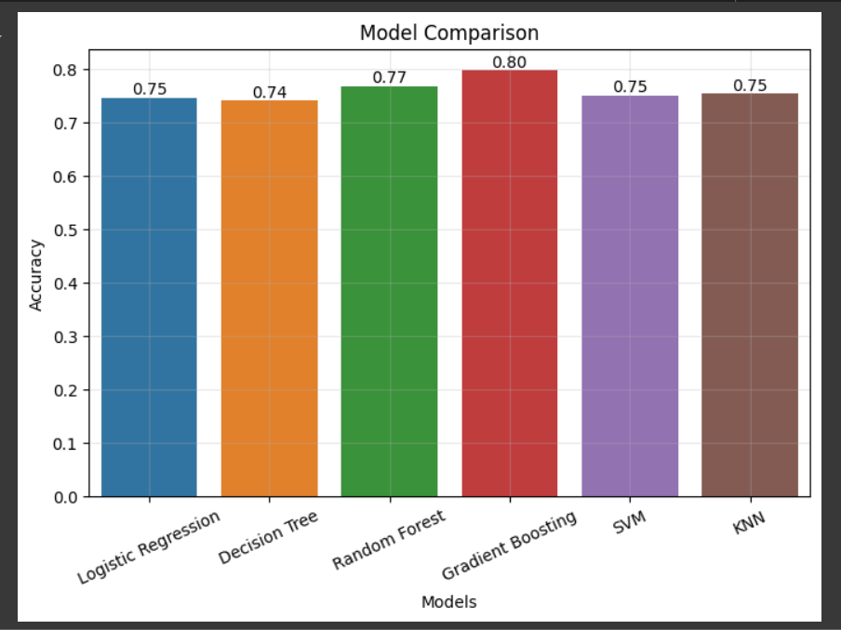
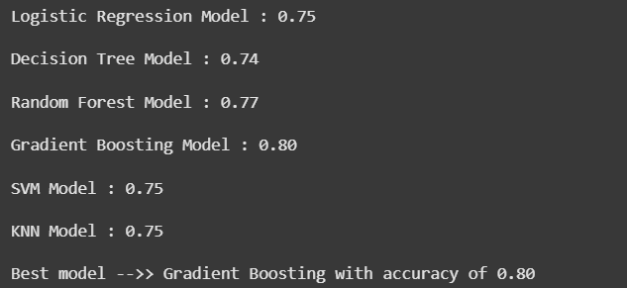
Result
Trail model – Logistic Regression
Multi Model Accuracy Score

Slide 9
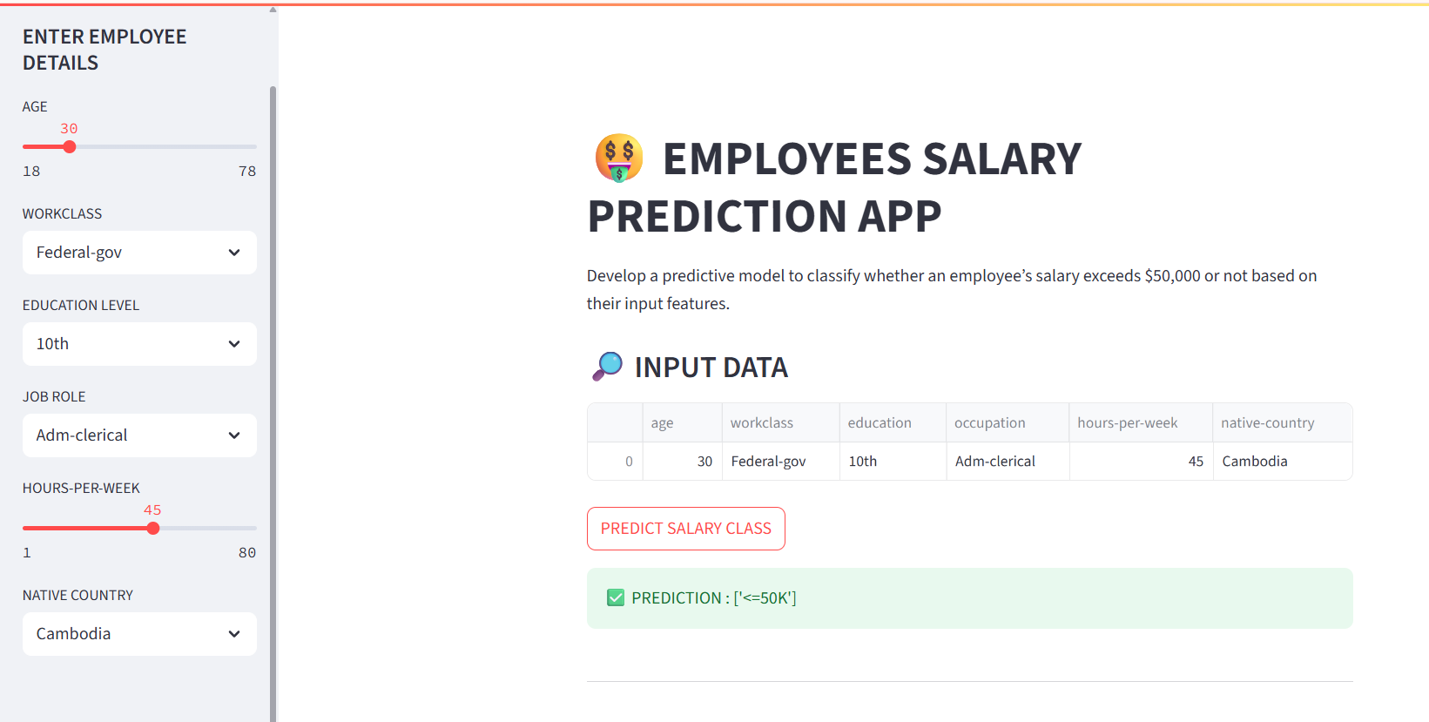
results
Gradient-Boosting Algorithm works best among all machine learning algorithms and results in 80% Accurate results which provides a good scalability in estimation for mass recruitment or generalise used for internal audits by HR Department.
GitHub Link - https://github.com/WOLF-212121/Employee-Salary-Prediction-Engine.git
Salary Prediction Engine Application

Slide 10
Conclusion
This project successfully demonstrated that machine learning can effectively predict employee salary brackets (> $50K or <= $50K) using real-life features such as age, education, and working hours, achieving an accuracy of 80% with Gradient Boosting. The proposed solution proved effective in assisting HR teams with data-driven, scalable, and fair salary analysis.
During implementation, challenges included handling missing values represented by '?', managing class imbalance, and fine-tuning models to improve accuracy without overfitting. Additionally, deploying the app using Streamlit and Ngrok required managing authorization tokens and server stability.
Future improvements could include integrating more features like job tenure and skill levels, implementing advanced hyperparameter tuning, and exploring cloud-based deployment for better scalability and user access within organizations.

Slide 11
Future scope
🚀 Potential Enhancements & Expansions
To further enhance accuracy, Neural Networks can be integrated to capture deeper patterns and complex relationships between features in the dataset.
Using Neural Networks may significantly improve predictive performance, especially with larger, diverse datasets.
However, this enhancement will require higher computational resources and will increase training time complexity, necessitating GPU utilization for efficient training.
Additionally, exploring cloud-based deployment (AWS, GCP, Azure) and API integration with HR systems can improve scalability and real-world usability.

Slide 12
References
📚 References
Streamlit Documentation and Research Papers Used for building an interactive web app for model deployment. Streamlit Official Docs
Ngrok Documentation and Articles Used for creating a secure API gateway and public URL for app access. Ngrok Documentation
Pyngrok Library Documentation Python wrapper for Ngrok, enabling seamless integration with Streamlit apps. Pyngrok Documentation
Scikit-Learn Documentation For implementing preprocessing, model building, and evaluation pipelines. Scikit-Learn User Guide
UCI Adult Income Dataset Utilized for employee salary classification based on demographic and work-related features. UCI Repository

Slide 13
THANK YOU

